Slide 1
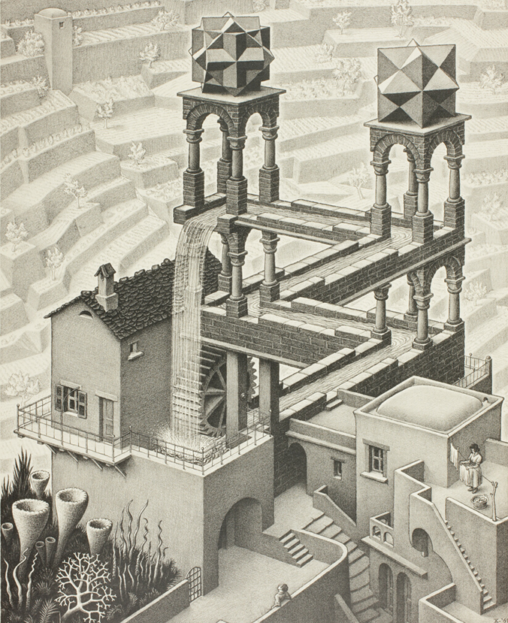

Simulation game “Risk & Race”
IL “Introduction to Circular Economy” WS 24-25
Kami Höferl
(Escher, 1961)

Slide 2
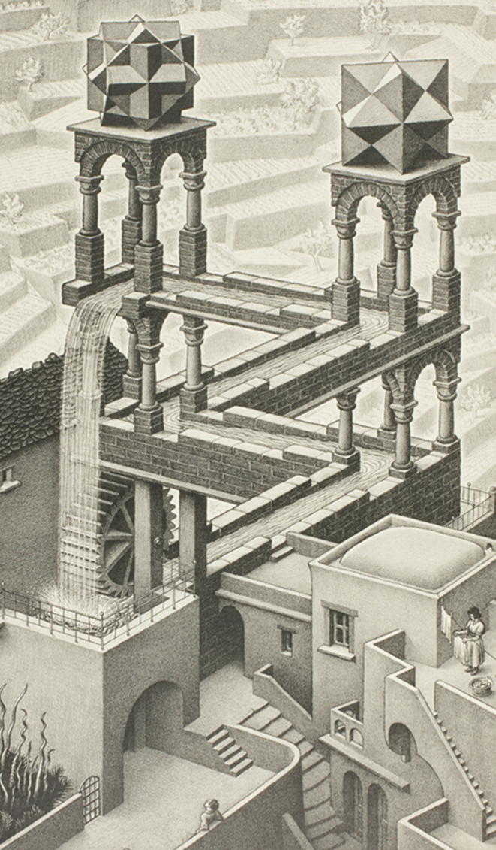
Overview
Where we are
Risk & Race Intro
Gameplay
Reflections
(Escher, 1961)
(Escher, 1961)

Slide 3
One size fits all?

Slide 4
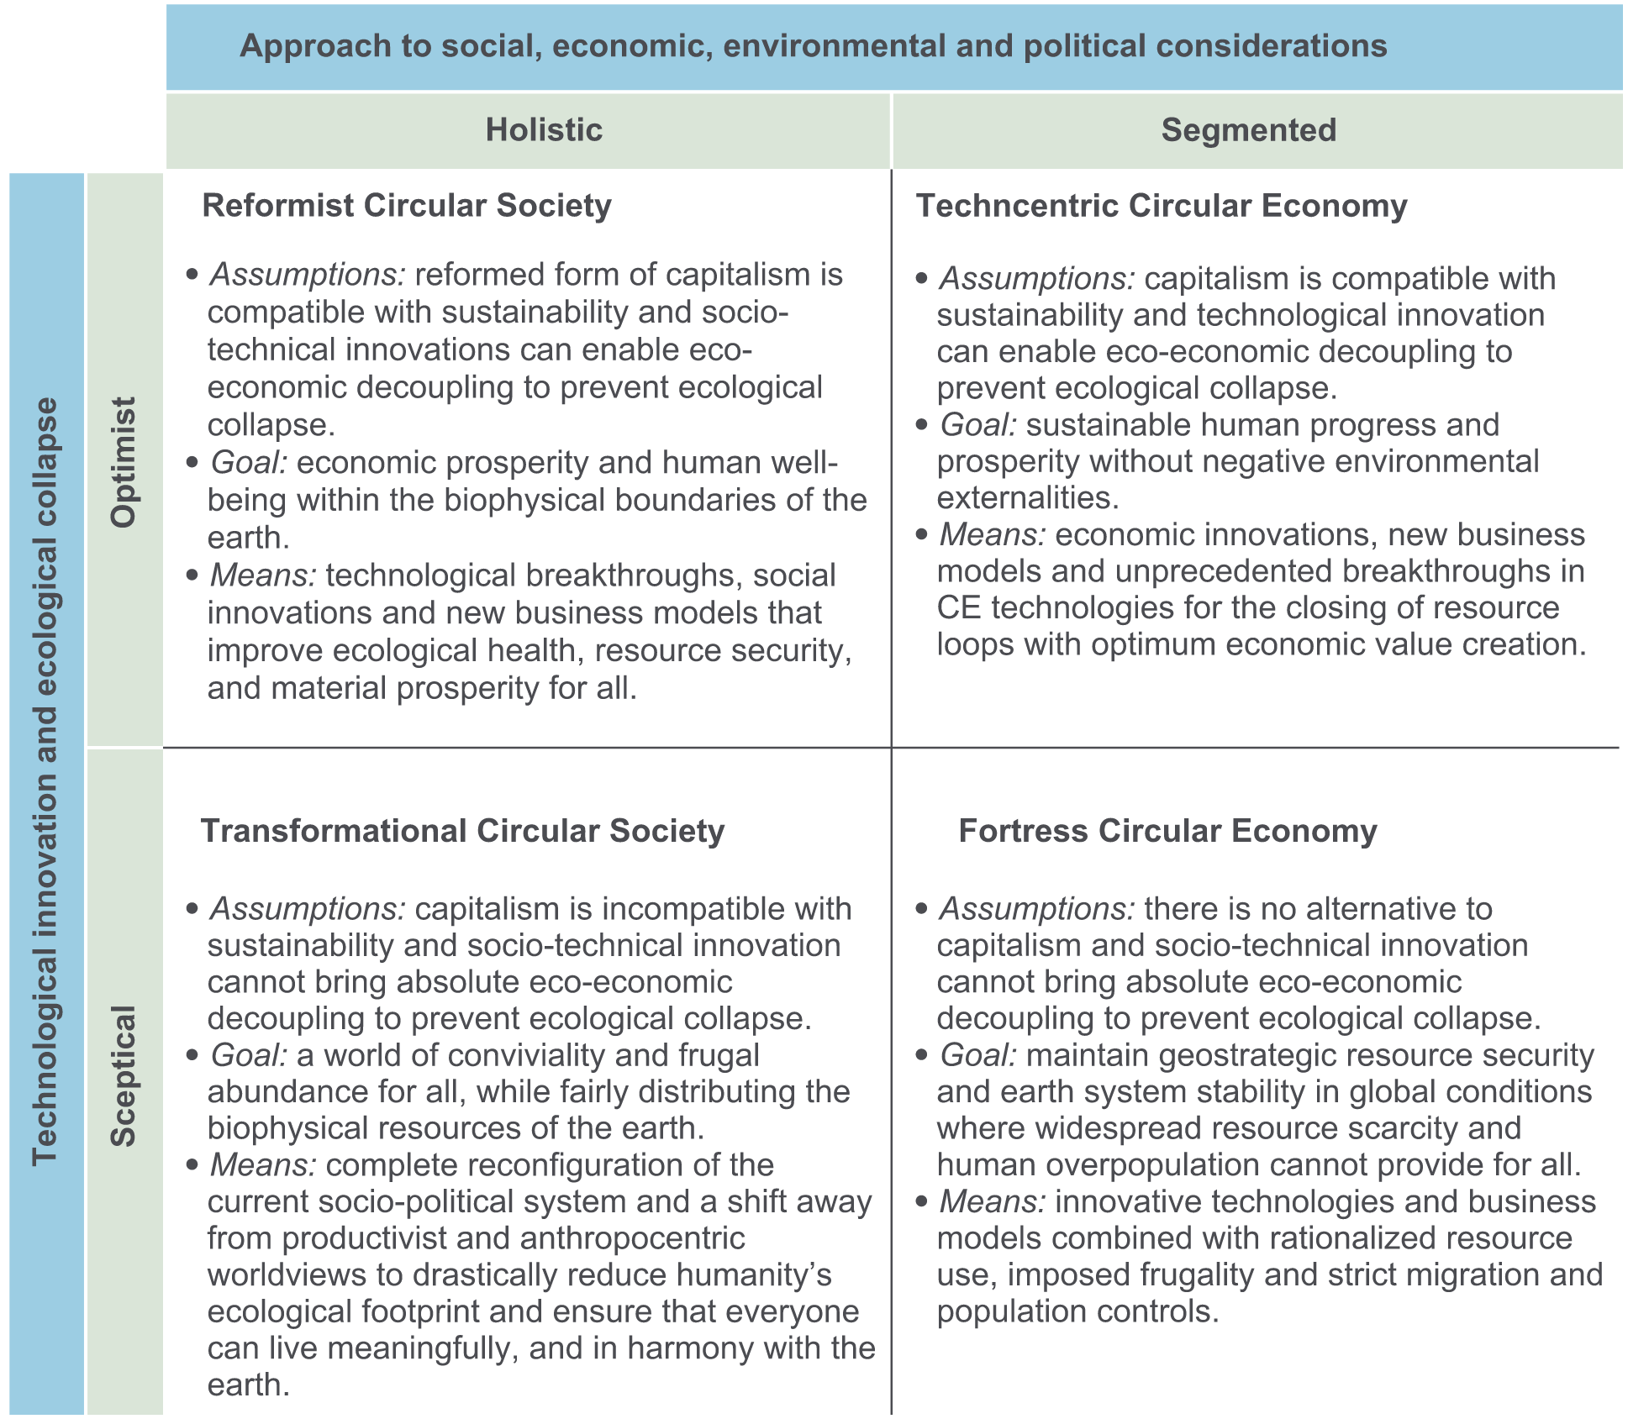
Revisiting the (theoretical) critique of conceptual fragmentation: Friant et al. (2020)

Slide 5
Friant et al.‘s (2020) Technocentric Circular Economy
👉 technological innovation & market-driven solutions
Key Strategies:
Innovation: Eco-design for durable, repairable, and recyclable products
Industrial symbiosis to optimise resource use between industries
Recycling and efficient resource management, refurbish to recover
Goals: Win-Win Green growth and decoupling economic growth from environmental harm
Strengths:
Promotes innovation and efficiency, compatible with existing capitalist systems
Criticisms:
Overlooks social justice and equity, limited focus on behavioural and systemic changes

Slide 6
Risk & RACE

Slide 7
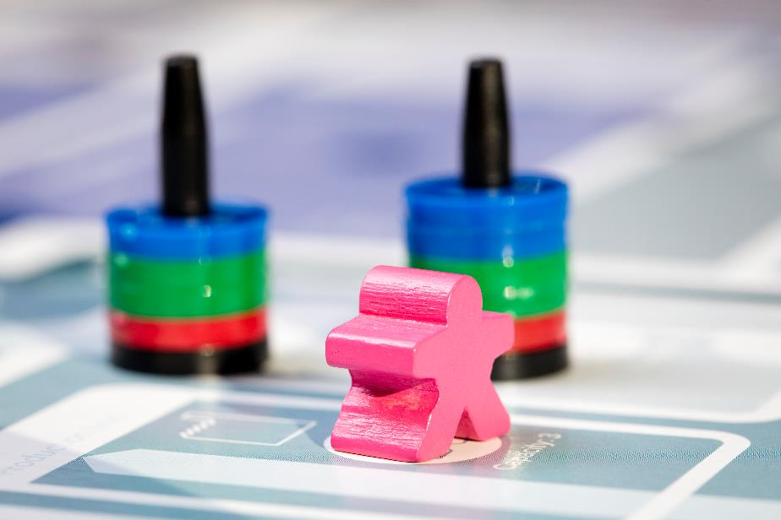

Let’s Play!

Slide 8
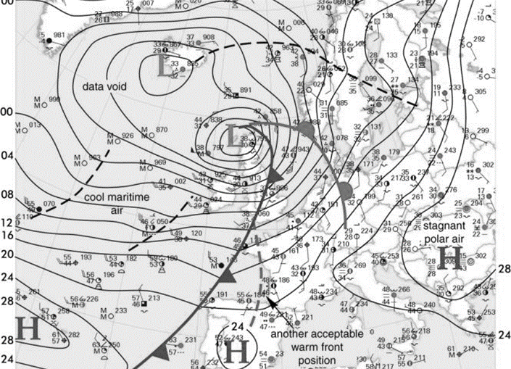


The Challenge
Navigate your company through stormy weather!

Slide 9
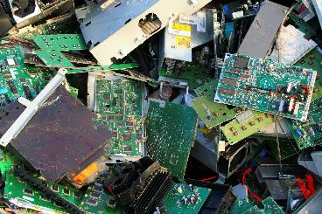
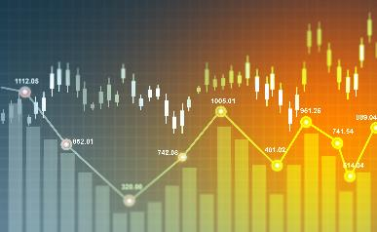


The Challenge
Limited resources
Price volatility
Changes in legislation
Technological development
Navigate your company through stormy weather!
Notes:
Events that may happen along the way

Slide 10
The Challenge
Your starting point
You have inherited a family business…
Your mission
Improve your resilience and company value…
Your strategy
Make smart investments…
Your team
Operations manager & Financial manager
Notes:
Game goal and narrative

Slide 11
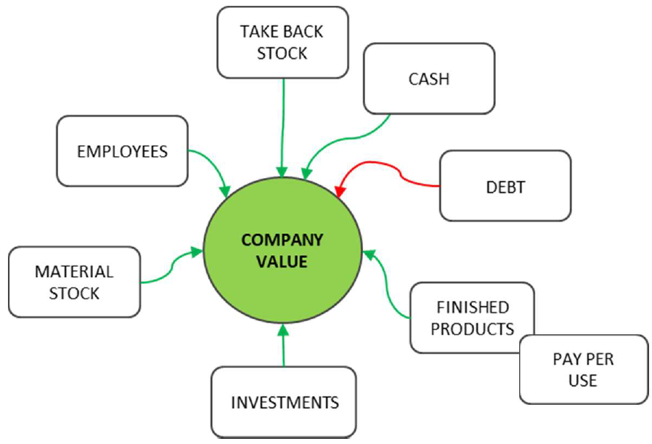
@ Mission: Resilience & company value

Slide 12
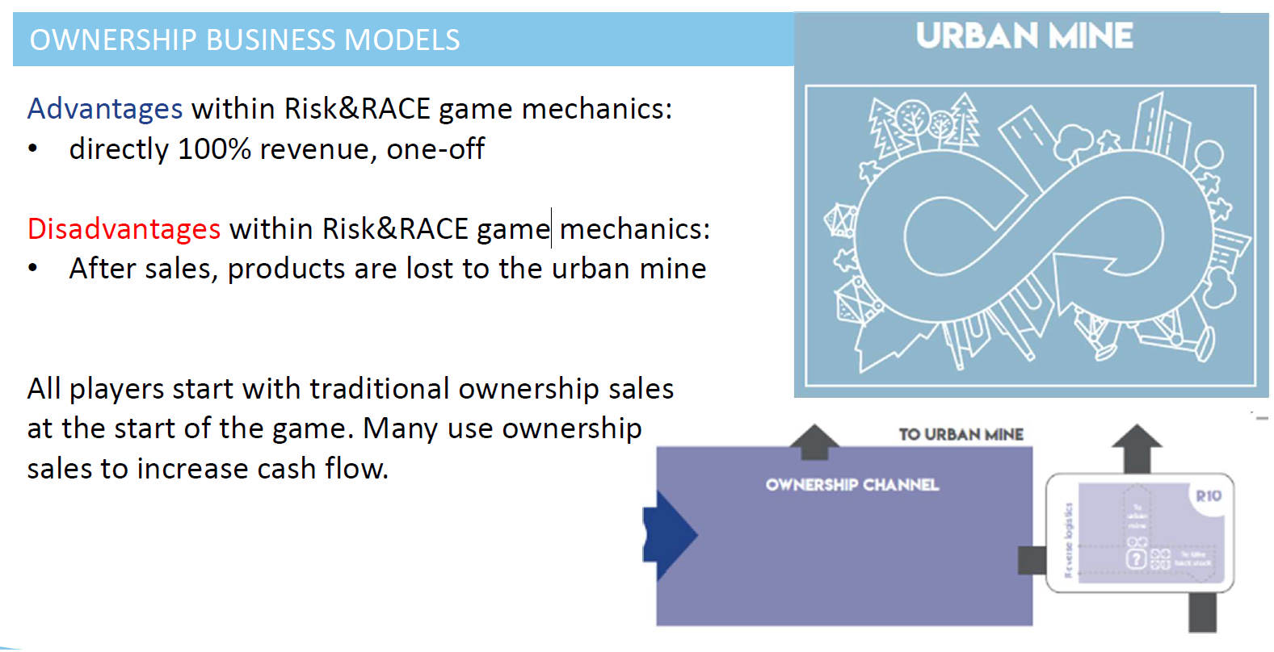
Business models: Ownership

Slide 13
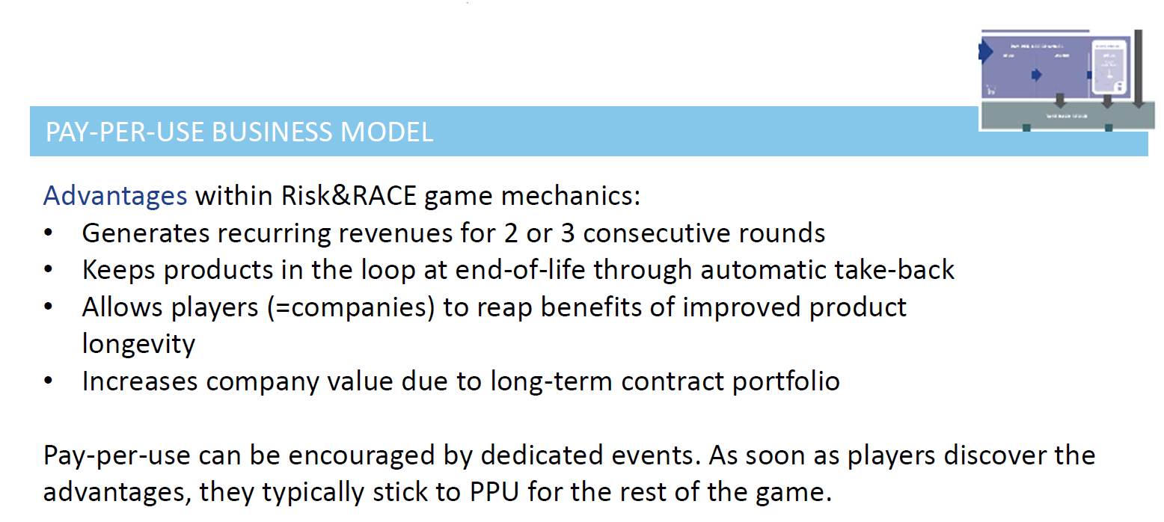
Business models: Pay-Per-Use

Slide 14
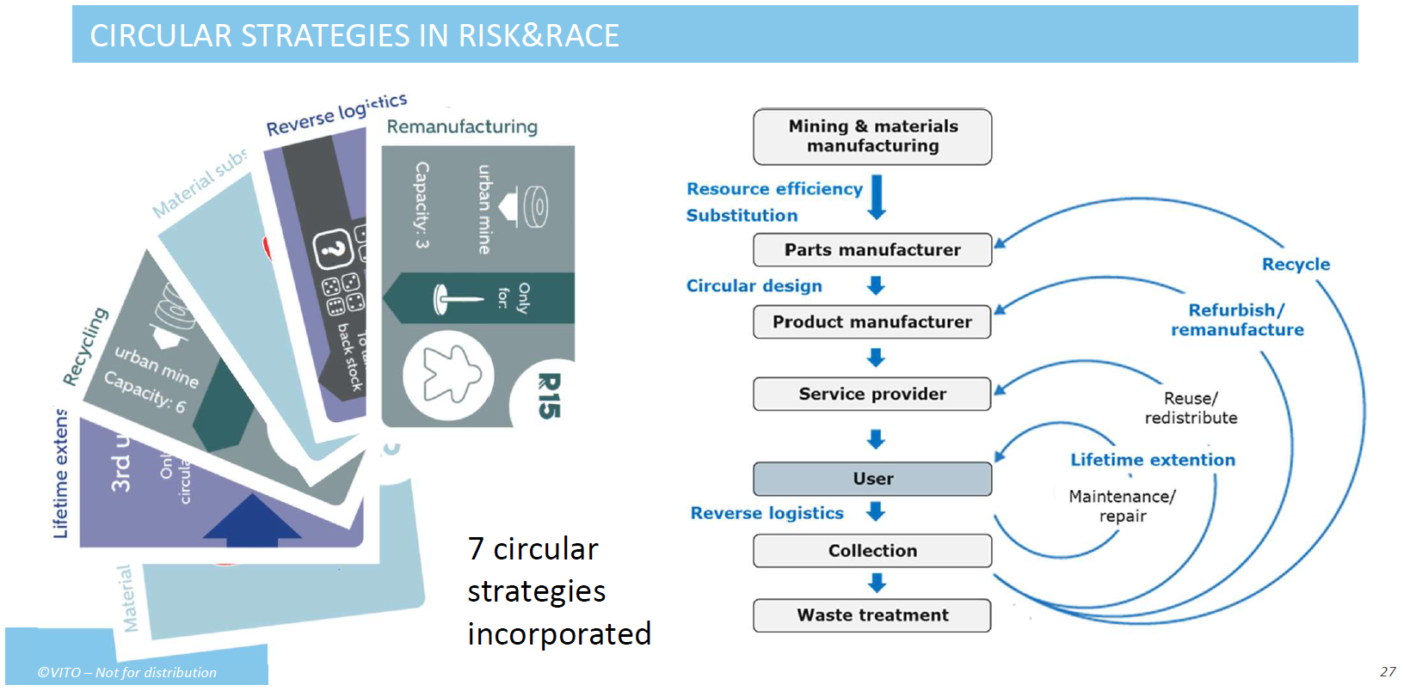
Circularity in the game

Slide 15
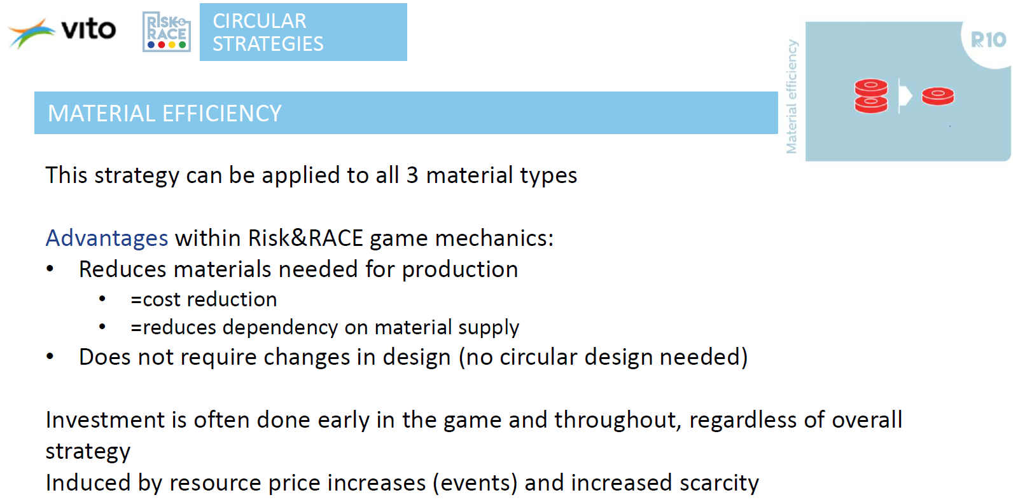
Circularity in the game

Slide 16
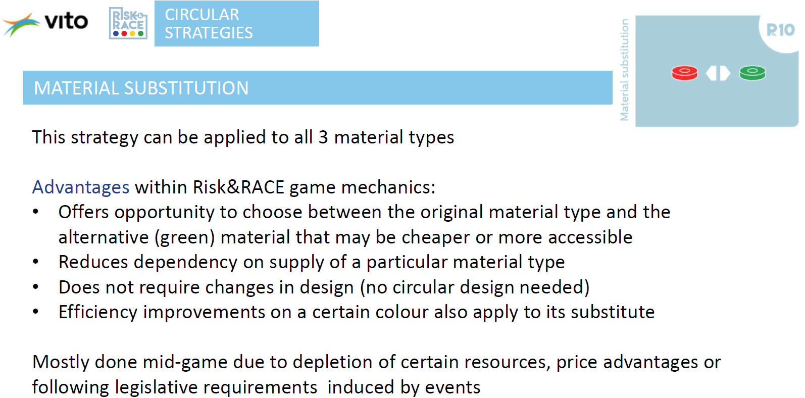
Circularity in the game

Slide 17
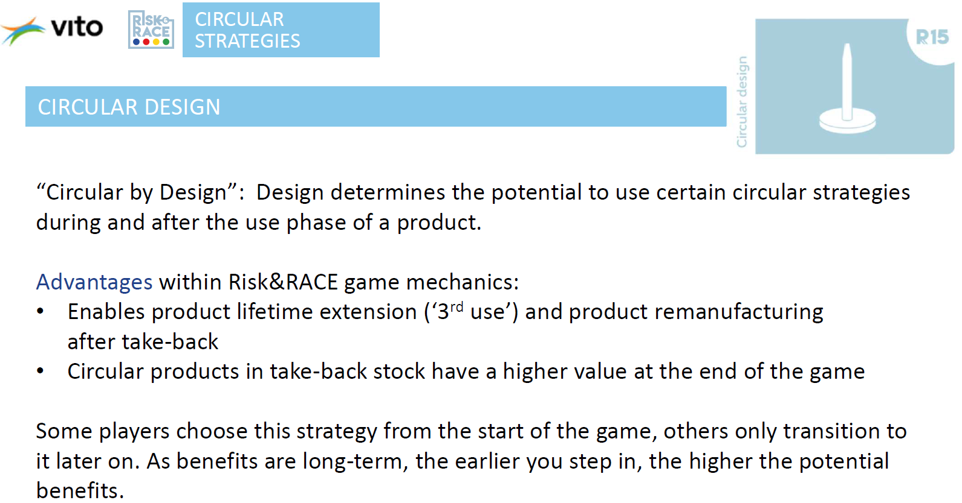
Circularity in the game

Slide 18
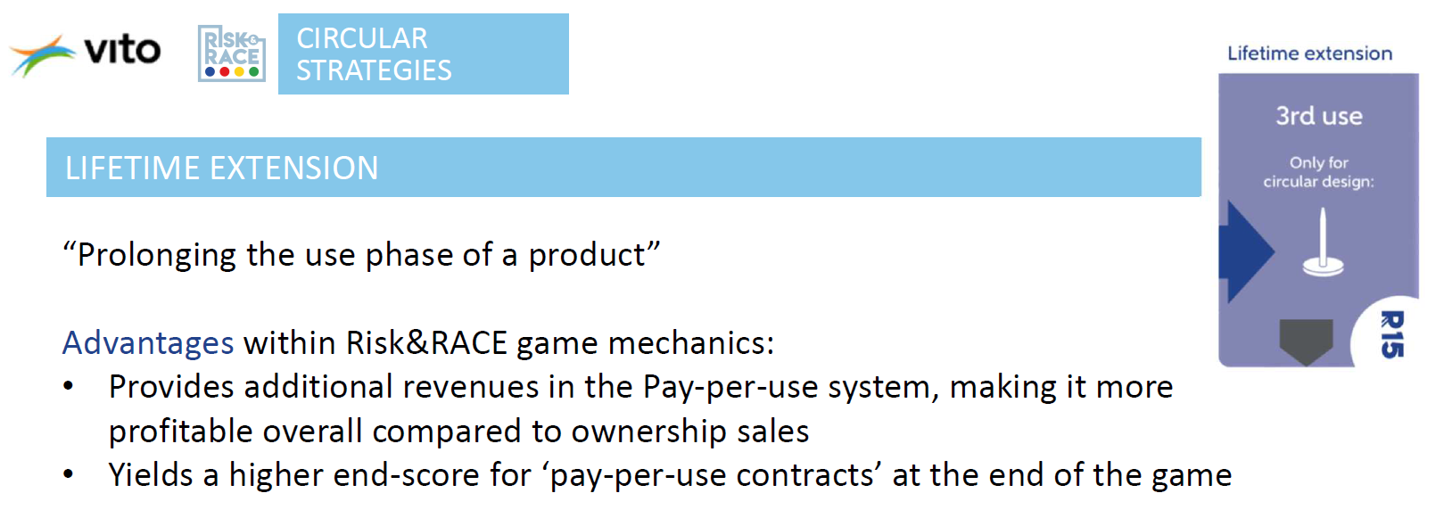
Circularity in the game

Slide 19
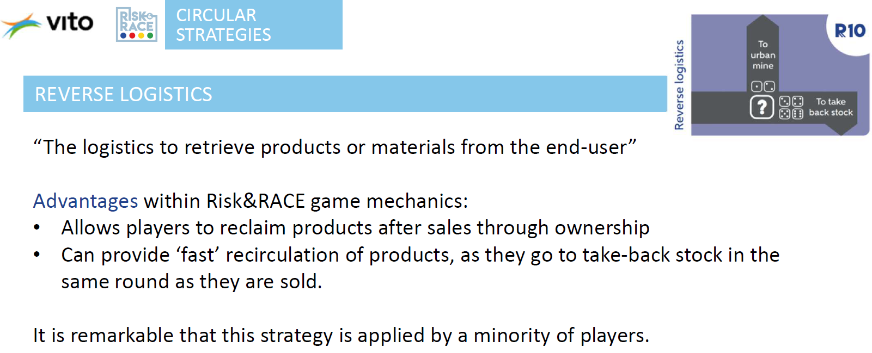
Circularity in the game

Slide 20
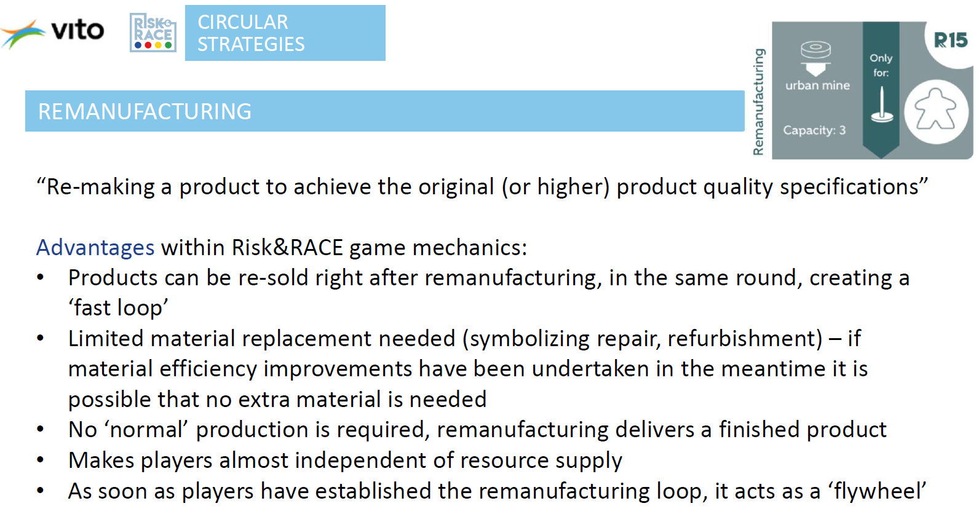
Circularity in the game

Slide 21
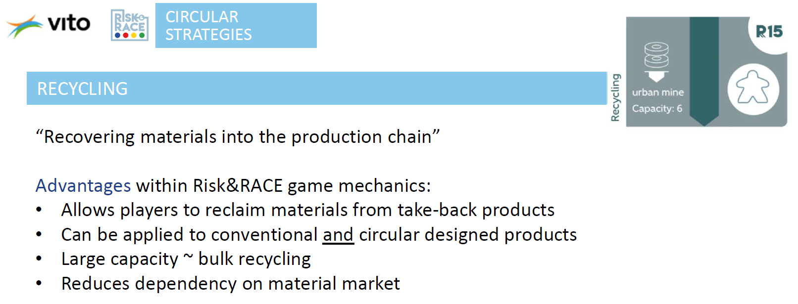
Circularity in the game

Slide 22
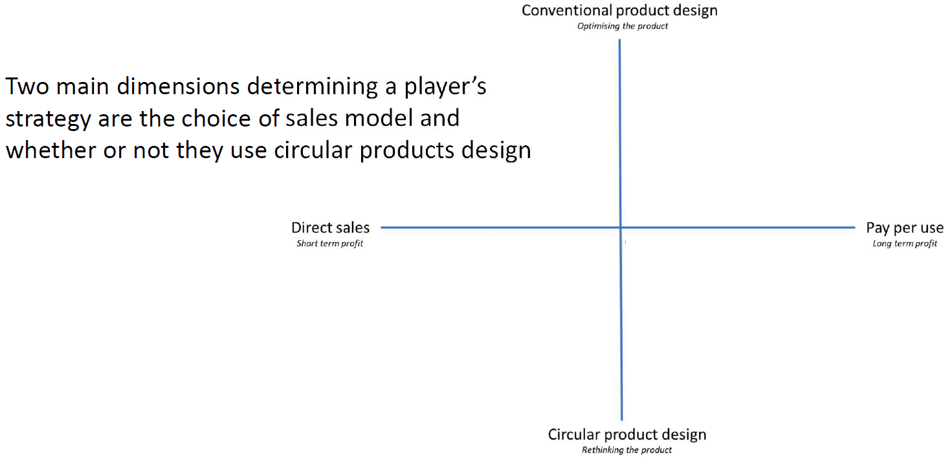
Overall game strategy

Slide 23
Your first task:
Form 8 groups:
1 | 2 | 3 | 4 | 5 | 6 | 7 | 8
Table A |  |  |  | Table B
Team 1 | Team 2 | Team 3 | Team 4 | Team 1 | Team 2 | Team 3 | Team 4

Slide 24
Debrief & assignment

Slide 25
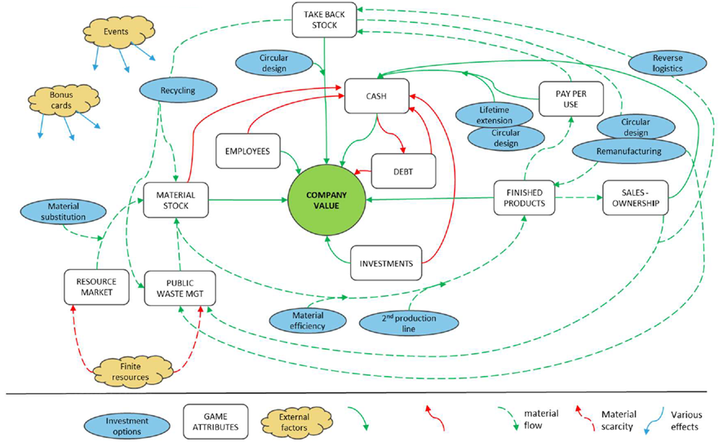
Overall game mechanics

Slide 26
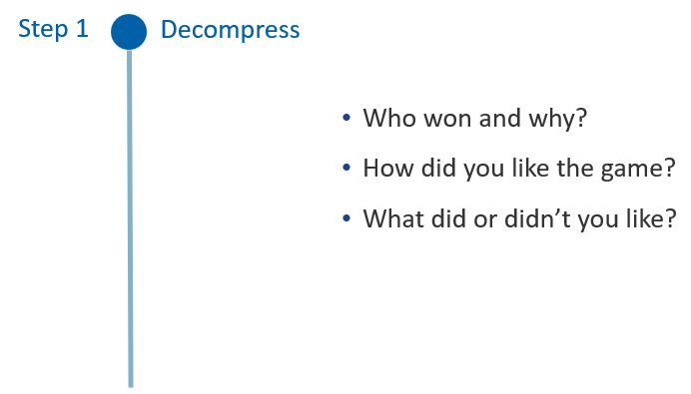
Debriefing

Slide 27
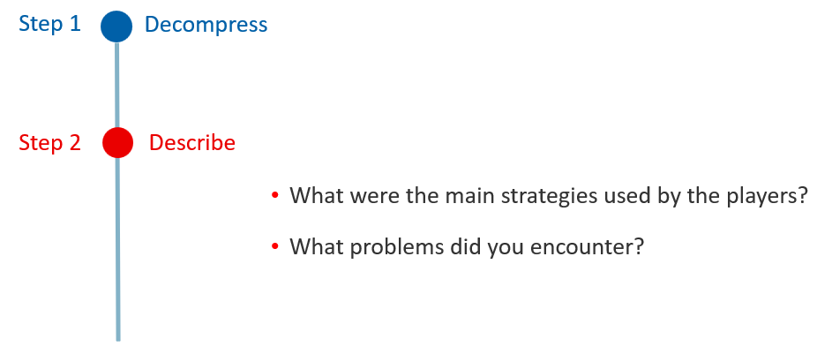
Debriefing

Slide 28
Debriefing
Step 1
Decompress
Step 2
Describe
Step 3
Analyse
What did the game learn you about circular business?
Did you recognize certain situations from the game in reality?

Slide 29
Your assignment: Debriefing Report
Cover page (1 page)
Description of assignment: What, when, who, aims (~ 0,5 pages)
Describe the game briefly (~1 page)
What did you like / disklike about the game? (~0,75 pages)
How would you describe your strategy (~ 2 pages)
Compared to the strategies other teams used: Would you change your strategy for a replay? (~ 1,5 pages)
Appendix A: Digital bookkeeping from your team (1 page)

Slide 30
Your assignment: Debriefing Report
Describe the game briefly:
Materials in Teams: Kursmaterialien / Materials / Risk_Race
Who, when, goals, implementation, duration, participants, gameplay, etc.

Slide 31
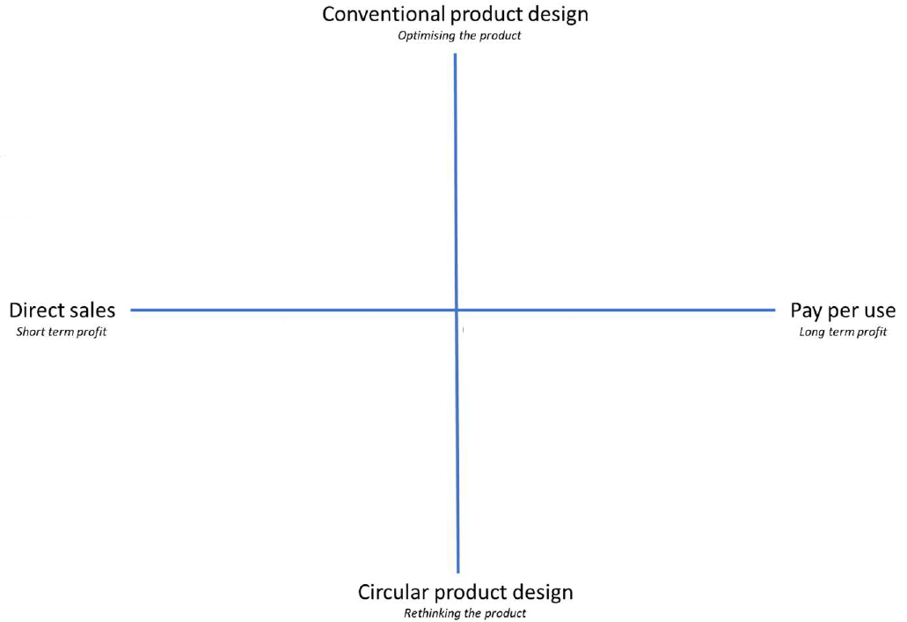
Your assignment: Debriefing Report
How would you describe your strategy:
Just one for the entire game, or changes
Changes: Why, when, what, etc.

Slide 32
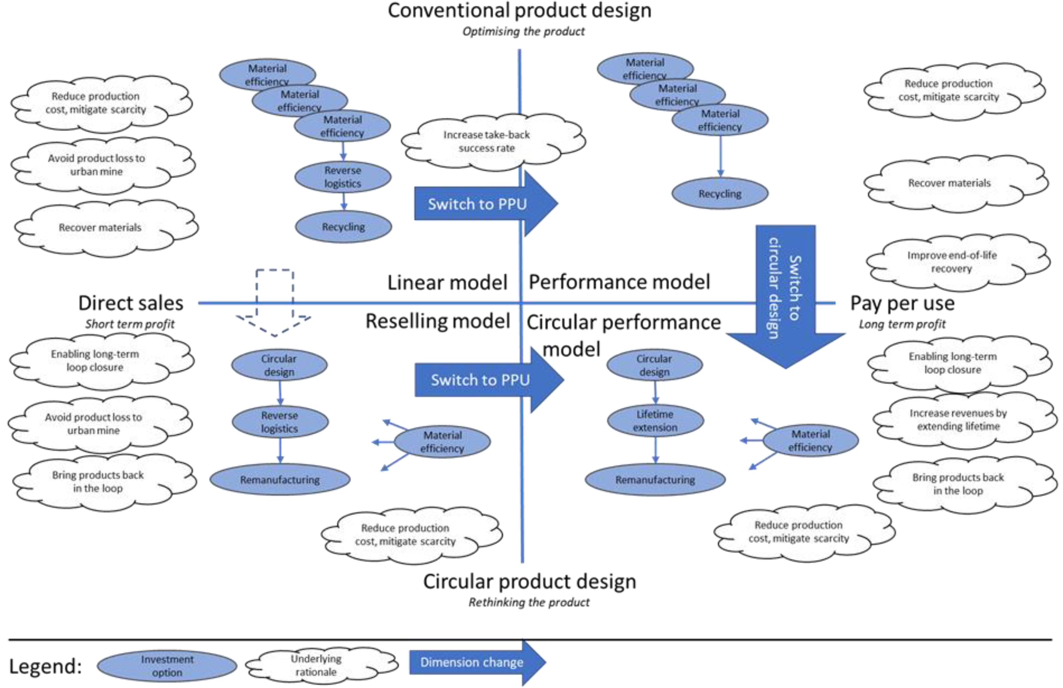
Overview on possible strategies

Slide 33
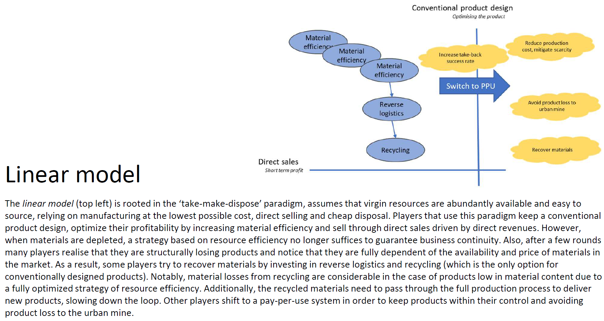
Overview on possible strategies

Slide 34
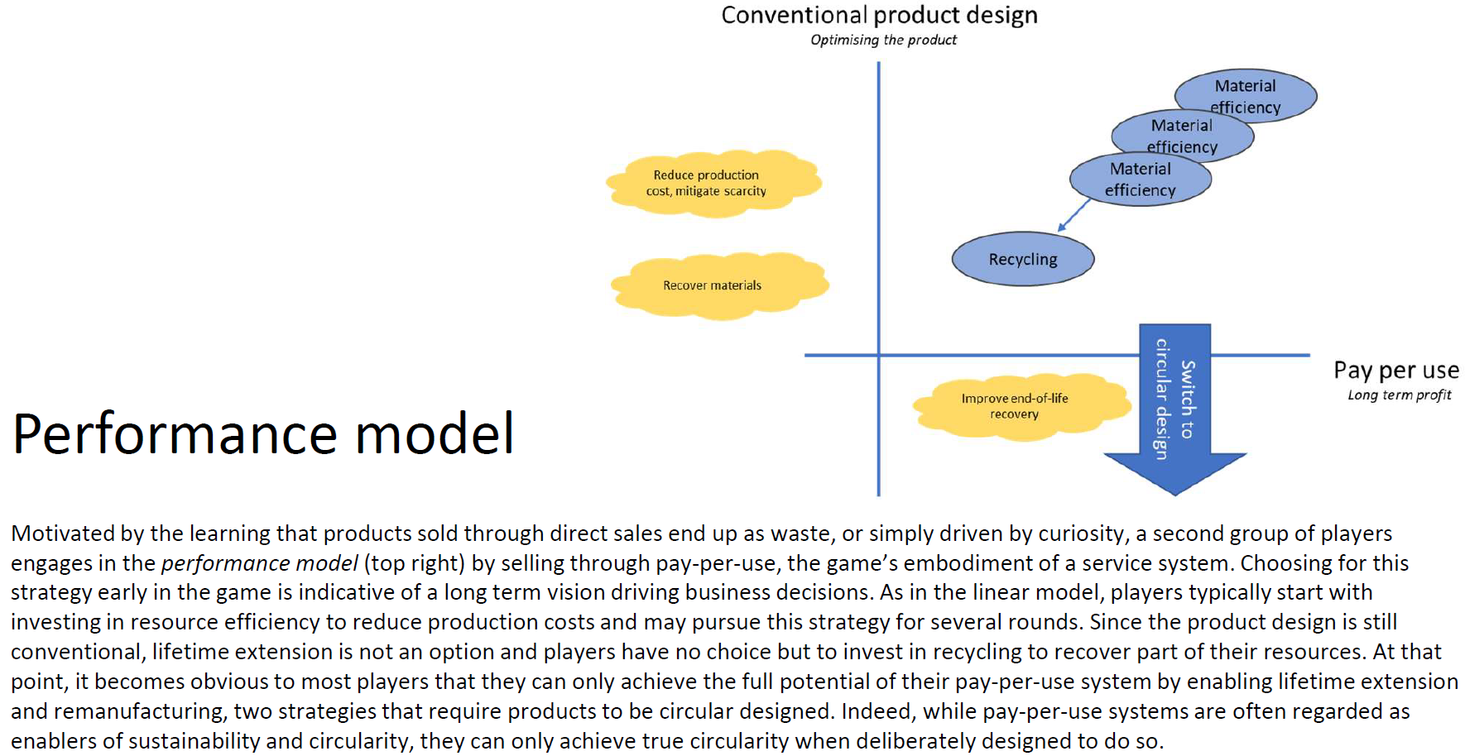
Overview on possible strategies

Slide 35
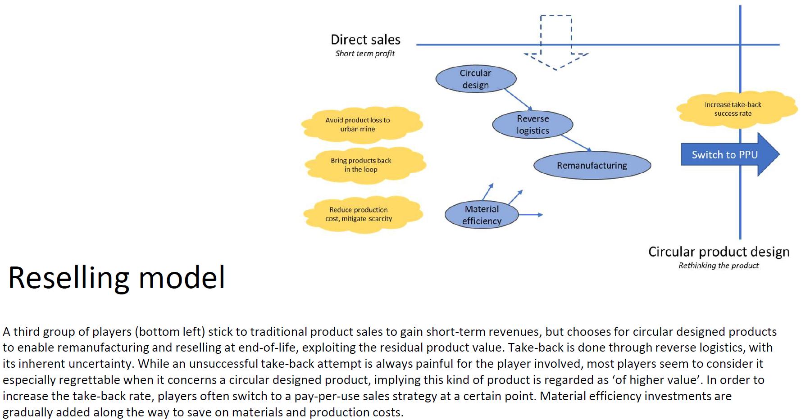
Overview on possible strategies

Slide 36
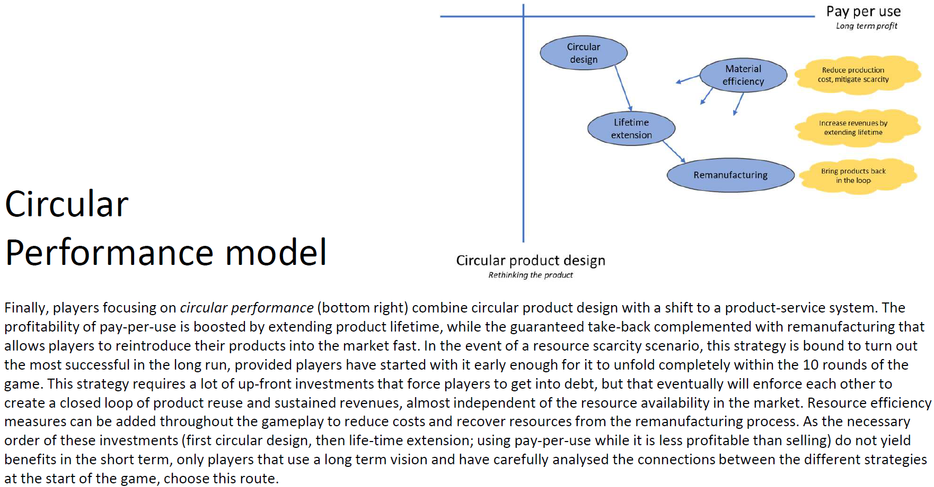
Overview on possible strategies

Slide 37
Your assignment: Debriefing Report
Hand in your report:
1 PDF A4 for each group
Name of the file: TableA_Team1.pdf
Teams: Upload in folder “1 Assignment”
📅 Deadline: 13.01.25, 12:00

Slide 38
Outlook

Slide 39
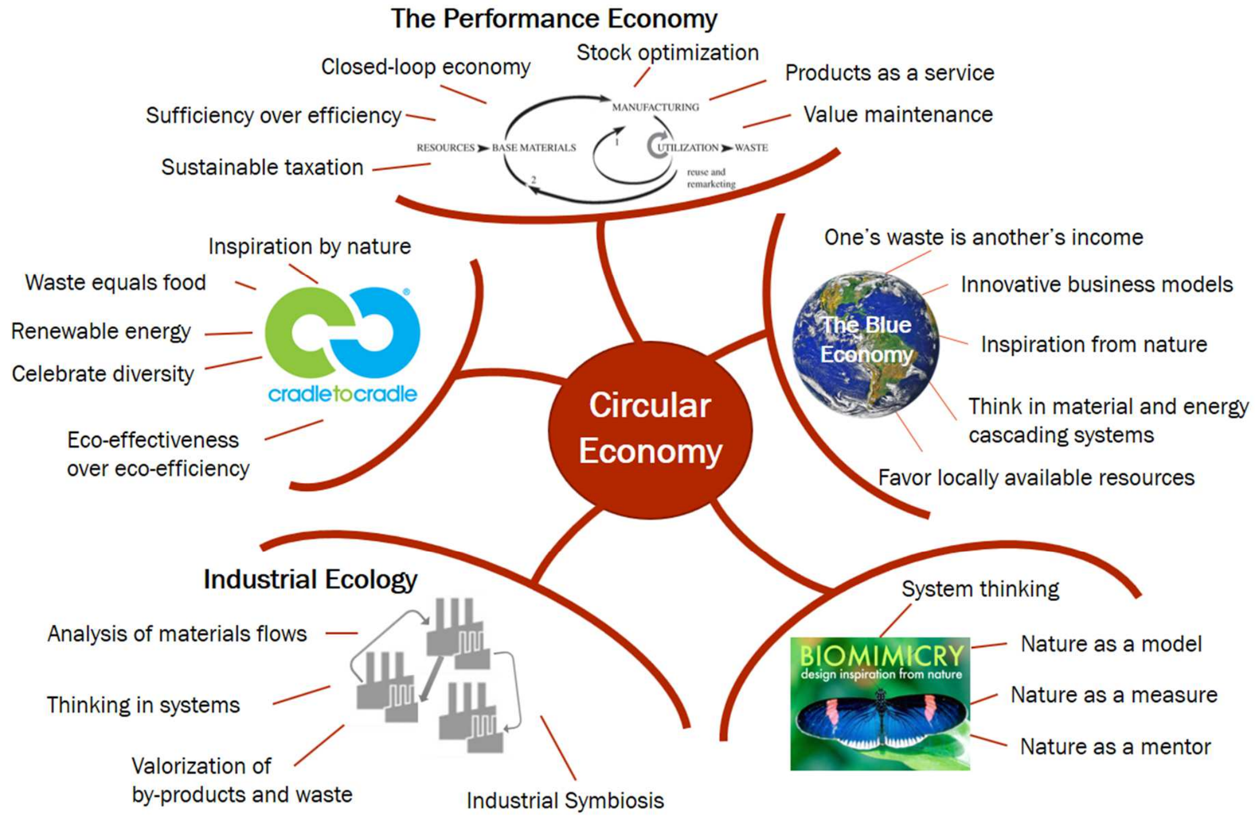
Wrap it up

Slide 40
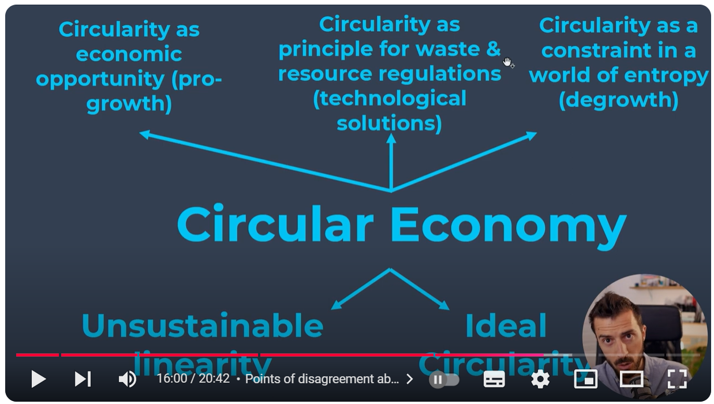
Till next session:
https://youtu.be/v_Xf3h5b3Y4

Slide 41
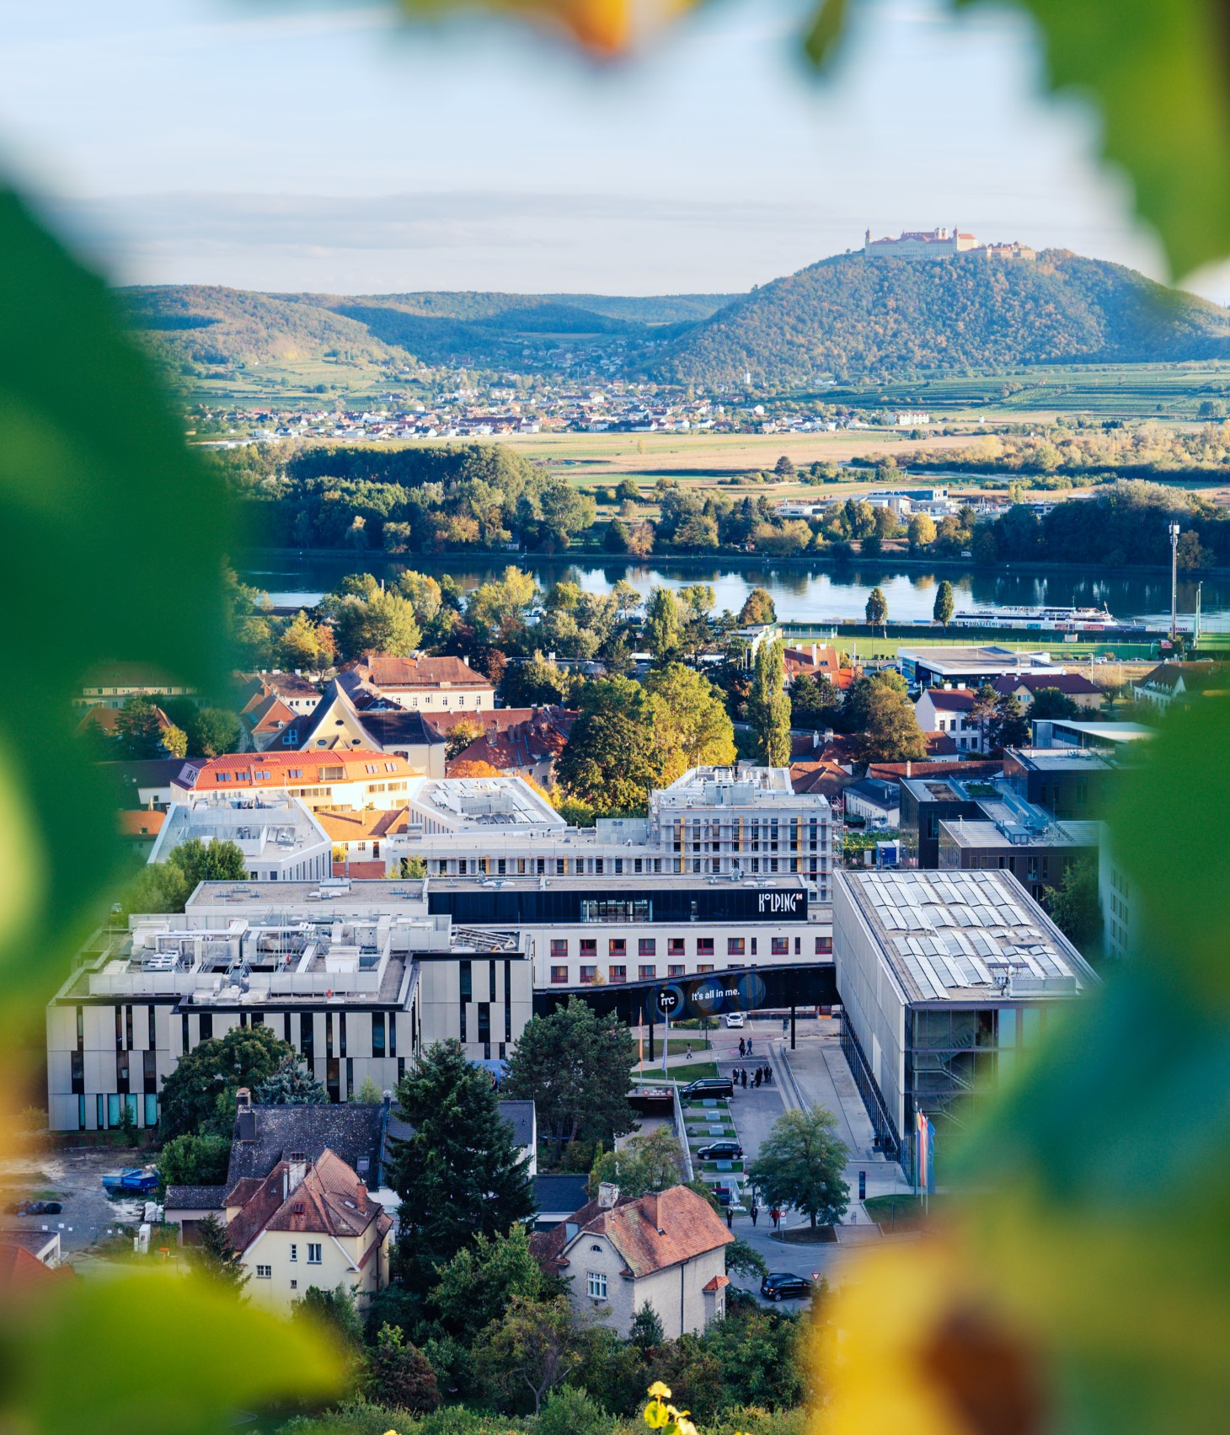

So long & cheerio!

